Slide 1

Lecture 1
Software Design and Architecture
Rana Taimur Khan
Lecturer GCUF

Slide 2
Design What and Why
What is Design:
Cambridge Dictionary Definition:
Verb
To make or draw plans for something, for example clothes or buildings.

Slide 3
Design What and Why
What is Design:
Cambridge Dictionary Definition:
Noun
A drawing or set of drawings showing how a building or product is to be made and how it will work and look.

Slide 4
Introduction to the Discipline of Design:
We live in a designed world.
Design is economically important and effects our quality of life
Any product that is an aggregate of more primitive elements, can benefit from the activity of design.

Slide 5
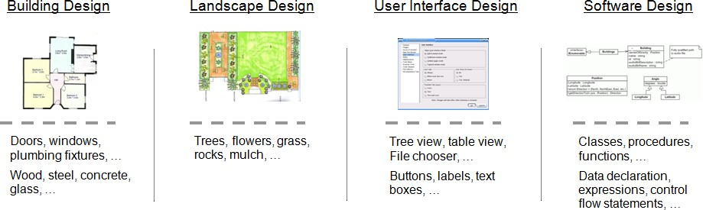
Introduction to the Discipline of Design:

Slide 6
Why we do design
“You can use an eraser on the drafting table or a sledgehammer on the construction side.”
Frank Lloyd Wright

Slide 7
Design Objectives
System Specification The Software Design Process
A “blueprint” for implementation

Slide 8
Design Objectives
During the design phase the software engineers apply their knowledge of:
The problem Domain
Implementation technologies

Slide 9
Design Objectives
Translate system specifications into plans for the technical implementation of the software.
Serve as a technical plan for implementation.
Specifies the overall structure and organization of the eventual code.
The system or program should meet customer's need.

Slide 10
What should be the design
Should be easy to implement.
Should be efficient
Should be easily extendible to meet new needs.

Slide 11
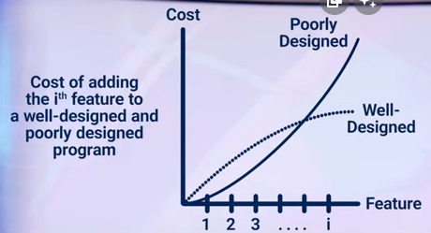
Software Design Complexity
Poorly design programs are difficult to understand and modify.

Slide 12
Software Design Complexity and Size
The size does matter
The larger the program the more pronounced are the consequences of poor design.

Slide 13
Software Design Types of Complexities
Mainly there are two types of Complexities
1. Essential Complexities
Complexities that are inherent in the problem
2. Accidental/Incidental Complexities
Complexities that are artifacts of the solution.

Slide 14
Software Design Types of Complexities
The total amount of complexity in a software solution is:
Essential Complexities
+
Accidental Complexities

Slide 15
Role of Design in Complexity
Design is an antidote to Complexity
Design is a primary tool for managing essential and accidental complexities in software.

Slide 16
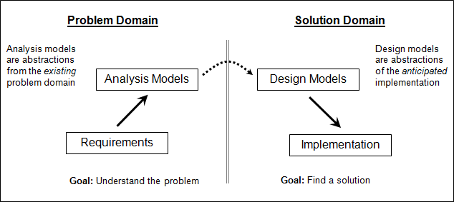
Software Design Why is Software Design Hard
Design is difficult because design is an abstraction of the solution which has yet to be created

Slide 17
Software Design A science or an Art
Science is a repeatable process
Art is not a repeatable process it can be unique

Slide 18
Difficulty with Design
Design is an art as well as Science

Slide 19
Software Design A Wicked Problem
Wicked Problem:
A problem that can only be clearly defined by completely solving it
-Even those proficient at software design might not be able to fully explain how they arrived at the result.

Slide 20
Design Process More Systematic and Predictable
The design process can be made more systematic and predictable through the applications of methods, techniques and patterns all applied according to principles and heuristics.

Slide 21
Dealing with Software Complexity Different rules and principles
1. Essential Complexities 2. Accidental/Incidental Complexities
Complexities that are Complexities that are artifacts
inherent in the problem of the solution.
Good design does not reduce the total amount of essential complexity in a solution, but it will reduce the amount of complexity that a programmer has to deal with at any one time.
A good design will manage essential complexities inherent in the problem without adding to accidental complexities consequential to the solution.

Slide 22
Dealing with Software Complexity Different rules and principles
1. Modularity:
We subdivide the solution into smaller and easier to manage components. After that we apply Divide and Conquer rule.
2. Hierarchical Organization:
Larger components maybe composed of smaller components.

Slide 23
Dealing with Software Complexity Different rules and principles
3. Information Hiding:
Hide details and complexity behind simple interface.
4. Abstraction:
Use abstraction to suppress details in place where they are unnecessary.

